Slide 1

IAM Technologies
CIS 360 – Prof. C. R. Johnson
University of Wisconsin – Stevens Point

Slide 2
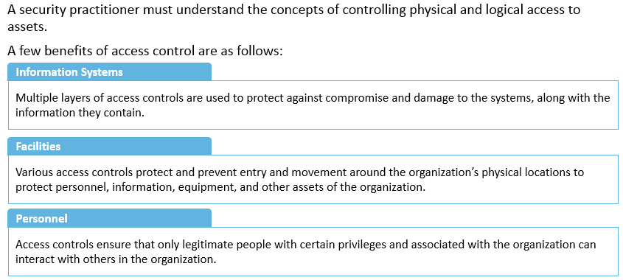
Controlling Physical and Logical Access to Assets
Notes:
Section breaker slide with customer logo
Section heading – Arial Headings, 34, Bold
Sub head – Arial Headings, 18, normal
Used for a section heading. You may add a sub heading not exceeding one line also here
Section heading – Arial Headings, bold, 34 font size, should not exceed beyond 1 line
Sub Head – Arial Headings, normal, 18 font size, should not exceed beyond 1 line

Slide 3
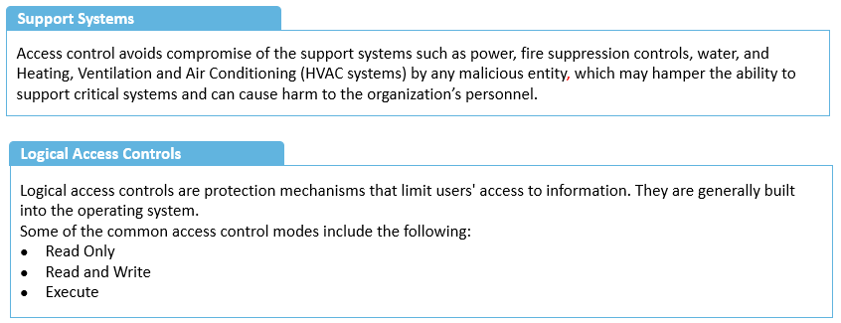
Controlling Physical and Logical Access to Assets (contd)
Notes:
Section breaker slide with customer logo
Section heading – Arial Headings, 34, Bold
Sub head – Arial Headings, 18, normal
Used for a section heading. You may add a sub heading not exceeding one line also here
Section heading – Arial Headings, bold, 34 font size, should not exceed beyond 1 line
Sub Head – Arial Headings, normal, 18 font size, should not exceed beyond 1 line

Slide 4
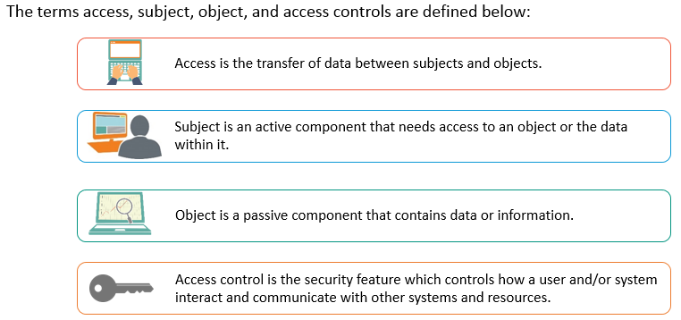
Access, Subject, Object and Access Control
Notes:
Section breaker slide with customer logo
Section heading – Arial Headings, 34, Bold
Sub head – Arial Headings, 18, normal
Used for a section heading. You may add a sub heading not exceeding one line also here
Section heading – Arial Headings, bold, 34 font size, should not exceed beyond 1 line
Sub Head – Arial Headings, normal, 18 font size, should not exceed beyond 1 line

Slide 5
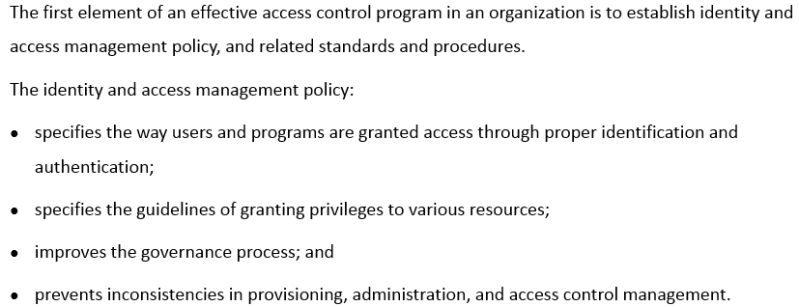
Identity and Access Management - Policy
Notes:
Section breaker slide with customer logo
Section heading – Arial Headings, 34, Bold
Sub head – Arial Headings, 18, normal
Used for a section heading. You may add a sub heading not exceeding one line also here
Section heading – Arial Headings, bold, 34 font size, should not exceed beyond 1 line
Sub Head – Arial Headings, normal, 18 font size, should not exceed beyond 1 line

Slide 6
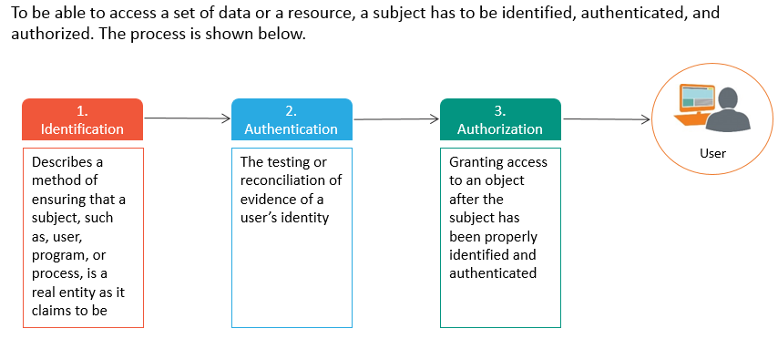
Identification, Authentication and Authorization
Notes:
Section breaker slide with customer logo
Section heading – Arial Headings, 34, Bold
Sub head – Arial Headings, 18, normal
Used for a section heading. You may add a sub heading not exceeding one line also here
Section heading – Arial Headings, bold, 34 font size, should not exceed beyond 1 line
Sub Head – Arial Headings, normal, 18 font size, should not exceed beyond 1 line

Slide 7
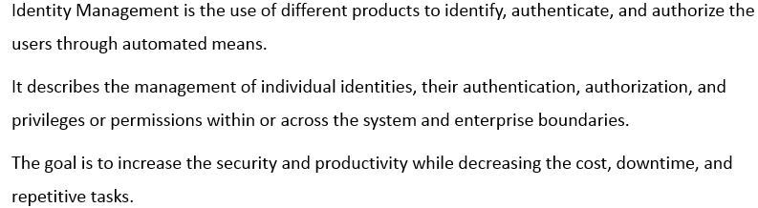
Identity Management
Notes:
Section breaker slide with customer logo
Section heading – Arial Headings, 34, Bold
Sub head – Arial Headings, 18, normal
Used for a section heading. You may add a sub heading not exceeding one line also here
Section heading – Arial Headings, bold, 34 font size, should not exceed beyond 1 line
Sub Head – Arial Headings, normal, 18 font size, should not exceed beyond 1 line

Slide 8
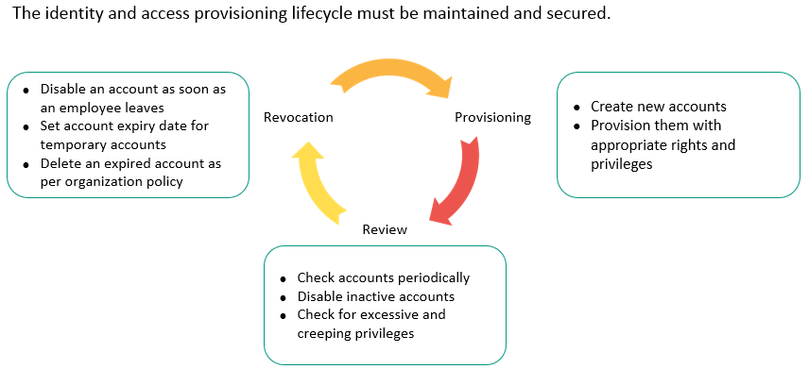
Identity and Access Provisioning Lifecycle
Notes:
Section breaker slide with customer logo
Section heading – Arial Headings, 34, Bold
Sub head – Arial Headings, 18, normal
Used for a section heading. You may add a sub heading not exceeding one line also here
Section heading – Arial Headings, bold, 34 font size, should not exceed beyond 1 line
Sub Head – Arial Headings, normal, 18 font size, should not exceed beyond 1 line

Slide 9
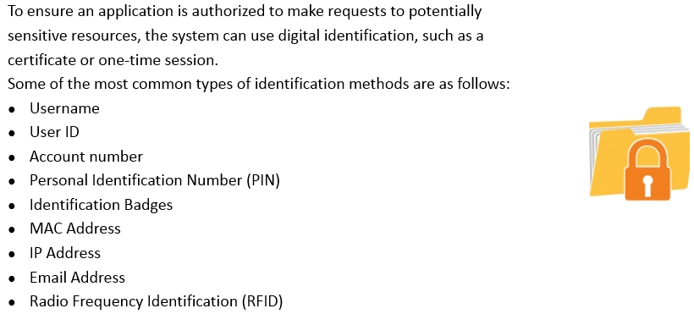
Identification Methods
Notes:
Section breaker slide with customer logo
Section heading – Arial Headings, 34, Bold
Sub head – Arial Headings, 18, normal
Used for a section heading. You may add a sub heading not exceeding one line also here
Section heading – Arial Headings, bold, 34 font size, should not exceed beyond 1 line
Sub Head – Arial Headings, normal, 18 font size, should not exceed beyond 1 line

Slide 10
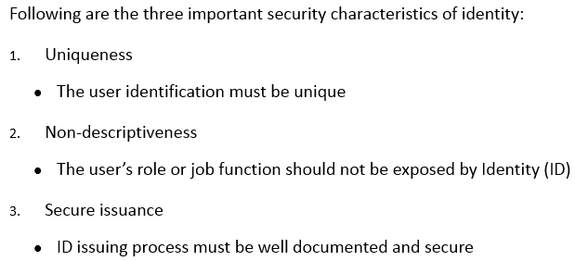
Guidelines for User Identification
Notes:
Section breaker slide with customer logo
Section heading – Arial Headings, 34, Bold
Sub head – Arial Headings, 18, normal
Used for a section heading. You may add a sub heading not exceeding one line also here
Section heading – Arial Headings, bold, 34 font size, should not exceed beyond 1 line
Sub Head – Arial Headings, normal, 18 font size, should not exceed beyond 1 line

Slide 11
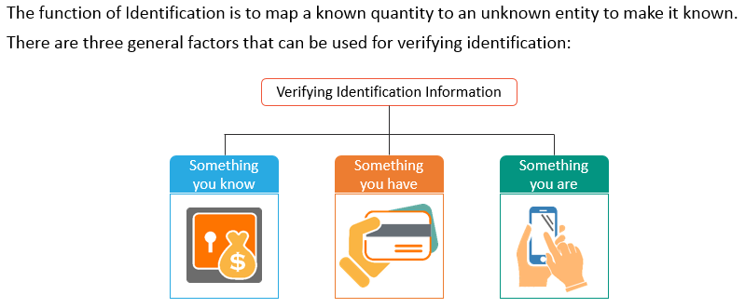
Verifying Identification Information
Notes:
Section breaker slide with customer logo
Section heading – Arial Headings, 34, Bold
Sub head – Arial Headings, 18, normal
Used for a section heading. You may add a sub heading not exceeding one line also here
Section heading – Arial Headings, bold, 34 font size, should not exceed beyond 1 line
Sub Head – Arial Headings, normal, 18 font size, should not exceed beyond 1 line

Slide 12
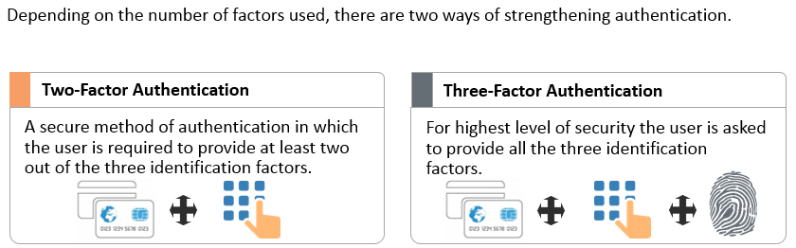
Strong Authentication
Notes:
Section breaker slide with customer logo
Section heading – Arial Headings, 34, Bold
Sub head – Arial Headings, 18, normal
Used for a section heading. You may add a sub heading not exceeding one line also here
Section heading – Arial Headings, bold, 34 font size, should not exceed beyond 1 line
Sub Head – Arial Headings, normal, 18 font size, should not exceed beyond 1 line

Slide 13
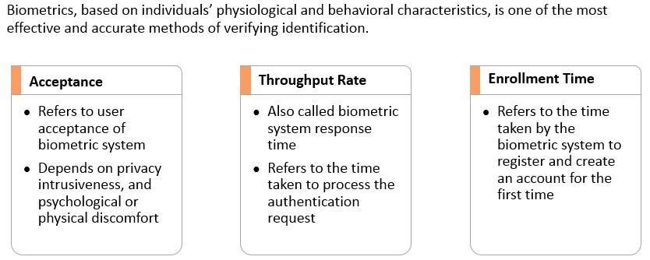
Biometrics – Characteristics
Notes:
Section breaker slide with customer logo
Section heading – Arial Headings, 34, Bold
Sub head – Arial Headings, 18, normal
Used for a section heading. You may add a sub heading not exceeding one line also here
Section heading – Arial Headings, bold, 34 font size, should not exceed beyond 1 line
Sub Head – Arial Headings, normal, 18 font size, should not exceed beyond 1 line

Slide 14
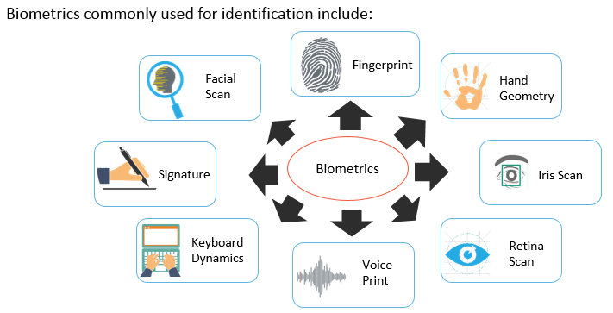
Biometrics - Types
Notes:
Section breaker slide with customer logo
Section heading – Arial Headings, 34, Bold
Sub head – Arial Headings, 18, normal
Used for a section heading. You may add a sub heading not exceeding one line also here
Section heading – Arial Headings, bold, 34 font size, should not exceed beyond 1 line
Sub Head – Arial Headings, normal, 18 font size, should not exceed beyond 1 line

Slide 15
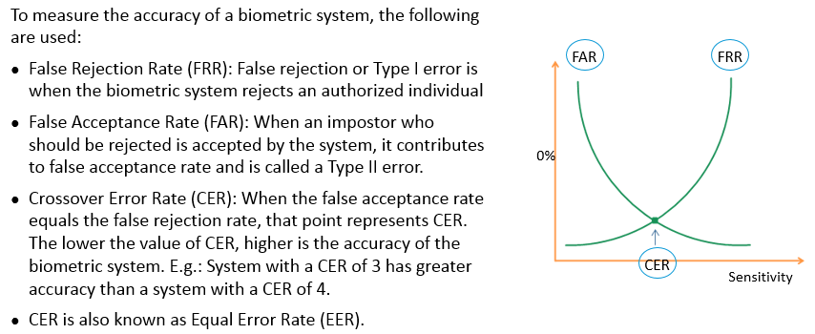
FRR, FAR and CER
Notes:
Section breaker slide with customer logo
Section heading – Arial Headings, 34, Bold
Sub head – Arial Headings, 18, normal
Used for a section heading. You may add a sub heading not exceeding one line also here
Section heading – Arial Headings, bold, 34 font size, should not exceed beyond 1 line
Sub Head – Arial Headings, normal, 18 font size, should not exceed beyond 1 line

Slide 16
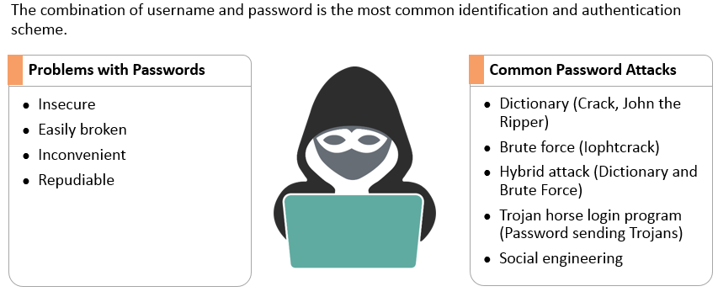
Passwords
Notes:
Section breaker slide with customer logo
Section heading – Arial Headings, 34, Bold
Sub head – Arial Headings, 18, normal
Used for a section heading. You may add a sub heading not exceeding one line also here
Section heading – Arial Headings, bold, 34 font size, should not exceed beyond 1 line
Sub Head – Arial Headings, normal, 18 font size, should not exceed beyond 1 line

Slide 17
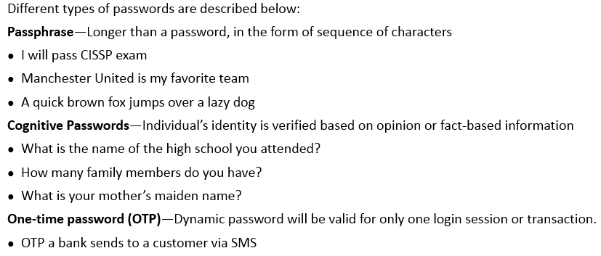
Passwords - Types
Notes:
Section breaker slide with customer logo
Section heading – Arial Headings, 34, Bold
Sub head – Arial Headings, 18, normal
Used for a section heading. You may add a sub heading not exceeding one line also here
Section heading – Arial Headings, bold, 34 font size, should not exceed beyond 1 line
Sub Head – Arial Headings, normal, 18 font size, should not exceed beyond 1 line

Slide 18
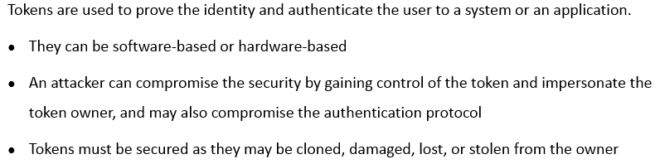
Tokens
Notes:
Section breaker slide with customer logo
Section heading – Arial Headings, 34, Bold
Sub head – Arial Headings, 18, normal
Used for a section heading. You may add a sub heading not exceeding one line also here
Section heading – Arial Headings, bold, 34 font size, should not exceed beyond 1 line
Sub Head – Arial Headings, normal, 18 font size, should not exceed beyond 1 line

Slide 19
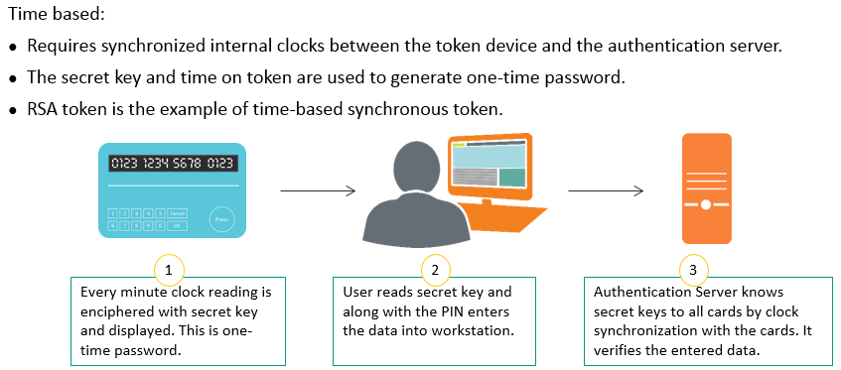
Token Device - Synchronous
Notes:
Section breaker slide with customer logo
Section heading – Arial Headings, 34, Bold
Sub head – Arial Headings, 18, normal
Used for a section heading. You may add a sub heading not exceeding one line also here
Section heading – Arial Headings, bold, 34 font size, should not exceed beyond 1 line
Sub Head – Arial Headings, normal, 18 font size, should not exceed beyond 1 line

Slide 20
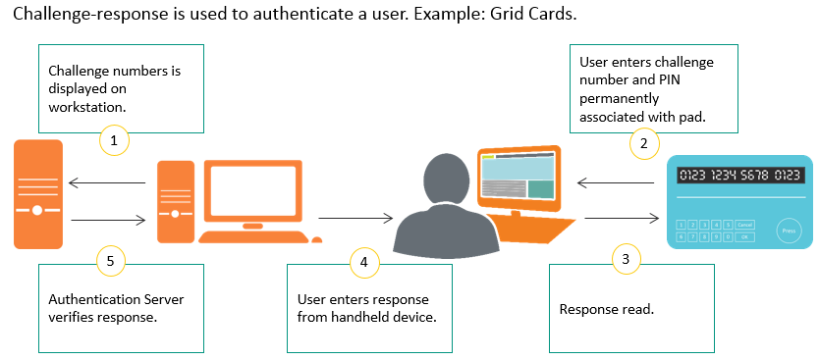
Token Device - Asynchronous
Notes:
Section breaker slide with customer logo
Section heading – Arial Headings, 34, Bold
Sub head – Arial Headings, 18, normal
Used for a section heading. You may add a sub heading not exceeding one line also here
Section heading – Arial Headings, bold, 34 font size, should not exceed beyond 1 line
Sub Head – Arial Headings, normal, 18 font size, should not exceed beyond 1 line

Slide 21
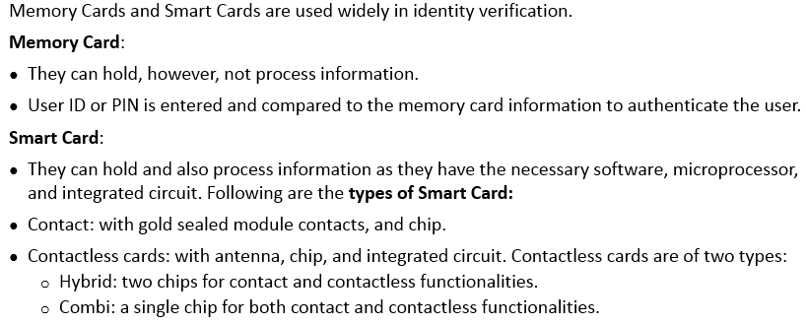
Memory Cards and Smart Cards
Notes:
Section breaker slide with customer logo
Section heading – Arial Headings, 34, Bold
Sub head – Arial Headings, 18, normal
Used for a section heading. You may add a sub heading not exceeding one line also here
Section heading – Arial Headings, bold, 34 font size, should not exceed beyond 1 line
Sub Head – Arial Headings, normal, 18 font size, should not exceed beyond 1 line

Slide 22
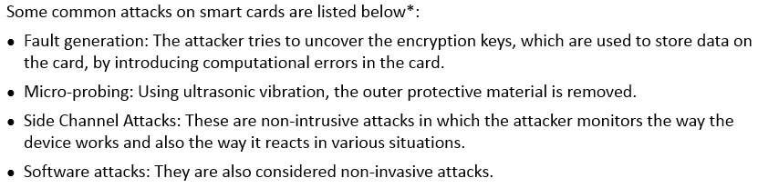
Attacks on Smart Cards
Notes:
Section breaker slide with customer logo
Section heading – Arial Headings, 34, Bold
Sub head – Arial Headings, 18, normal
Used for a section heading. You may add a sub heading not exceeding one line also here
Section heading – Arial Headings, bold, 34 font size, should not exceed beyond 1 line
Sub Head – Arial Headings, normal, 18 font size, should not exceed beyond 1 line

Slide 23
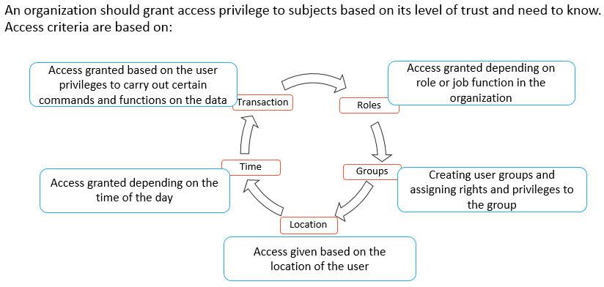
Access Criteria
Notes:
Section breaker slide with customer logo
Section heading – Arial Headings, 34, Bold
Sub head – Arial Headings, 18, normal
Used for a section heading. You may add a sub heading not exceeding one line also here
Section heading – Arial Headings, bold, 34 font size, should not exceed beyond 1 line
Sub Head – Arial Headings, normal, 18 font size, should not exceed beyond 1 line

Slide 24
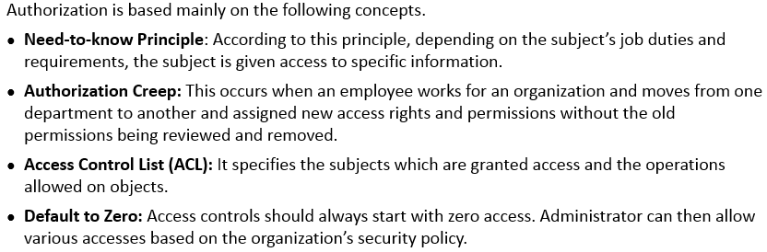
Authorization Concepts
Notes:
Section breaker slide with customer logo
Section heading – Arial Headings, 34, Bold
Sub head – Arial Headings, 18, normal
Used for a section heading. You may add a sub heading not exceeding one line also here
Section heading – Arial Headings, bold, 34 font size, should not exceed beyond 1 line
Sub Head – Arial Headings, normal, 18 font size, should not exceed beyond 1 line

Slide 25
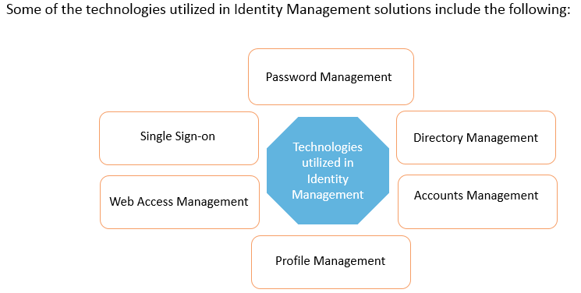
Identity Management - Implementation
Notes:
Section breaker slide with customer logo
Section heading – Arial Headings, 34, Bold
Sub head – Arial Headings, 18, normal
Used for a section heading. You may add a sub heading not exceeding one line also here
Section heading – Arial Headings, bold, 34 font size, should not exceed beyond 1 line
Sub Head – Arial Headings, normal, 18 font size, should not exceed beyond 1 line

Slide 26
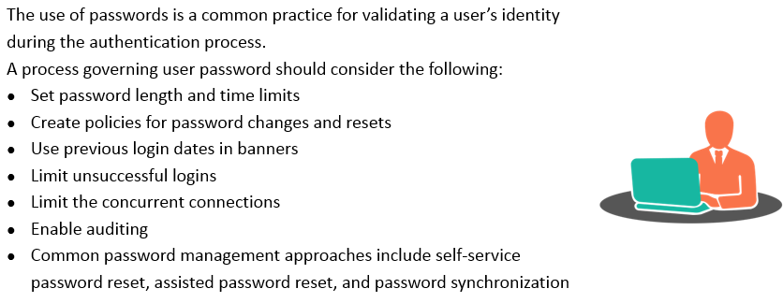
Password Management
Notes:
Section breaker slide with customer logo
Section heading – Arial Headings, 34, Bold
Sub head – Arial Headings, 18, normal
Used for a section heading. You may add a sub heading not exceeding one line also here
Section heading – Arial Headings, bold, 34 font size, should not exceed beyond 1 line
Sub Head – Arial Headings, normal, 18 font size, should not exceed beyond 1 line

Slide 27
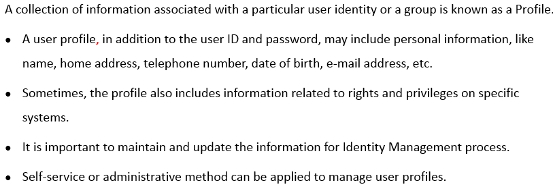
Profile Management
Notes:
Section breaker slide with customer logo
Section heading – Arial Headings, 34, Bold
Sub head – Arial Headings, 18, normal
Used for a section heading. You may add a sub heading not exceeding one line also here
Section heading – Arial Headings, bold, 34 font size, should not exceed beyond 1 line
Sub Head – Arial Headings, normal, 18 font size, should not exceed beyond 1 line

Slide 28
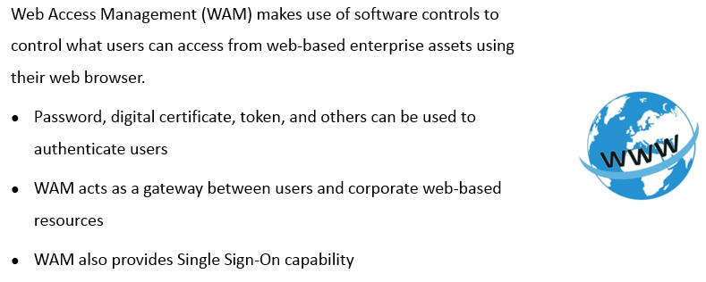
Web Access Management
Notes:
Section breaker slide with customer logo
Section heading – Arial Headings, 34, Bold
Sub head – Arial Headings, 18, normal
Used for a section heading. You may add a sub heading not exceeding one line also here
Section heading – Arial Headings, bold, 34 font size, should not exceed beyond 1 line
Sub Head – Arial Headings, normal, 18 font size, should not exceed beyond 1 line

Slide 29
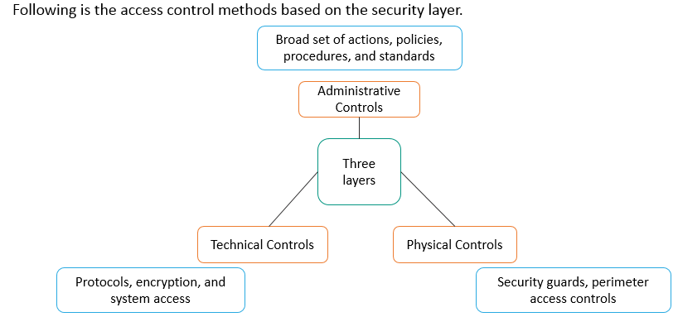
Access Related Controls
Notes:
Section breaker slide with customer logo
Section heading – Arial Headings, 34, Bold
Sub head – Arial Headings, 18, normal
Used for a section heading. You may add a sub heading not exceeding one line also here
Section heading – Arial Headings, bold, 34 font size, should not exceed beyond 1 line
Sub Head – Arial Headings, normal, 18 font size, should not exceed beyond 1 line

Slide 30
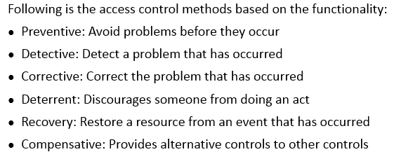
Access Control Method based on Functionality
Notes:
Section breaker slide with customer logo
Section heading – Arial Headings, 34, Bold
Sub head – Arial Headings, 18, normal
Used for a section heading. You may add a sub heading not exceeding one line also here
Section heading – Arial Headings, bold, 34 font size, should not exceed beyond 1 line
Sub Head – Arial Headings, normal, 18 font size, should not exceed beyond 1 line

Slide 31
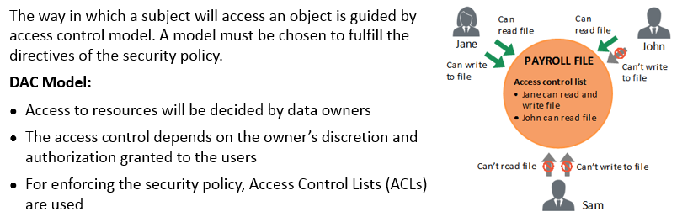
Access Control Models - DAC
Notes:
Section breaker slide with customer logo
Section heading – Arial Headings, 34, Bold
Sub head – Arial Headings, 18, normal
Used for a section heading. You may add a sub heading not exceeding one line also here
Section heading – Arial Headings, bold, 34 font size, should not exceed beyond 1 line
Sub Head – Arial Headings, normal, 18 font size, should not exceed beyond 1 line

Slide 32
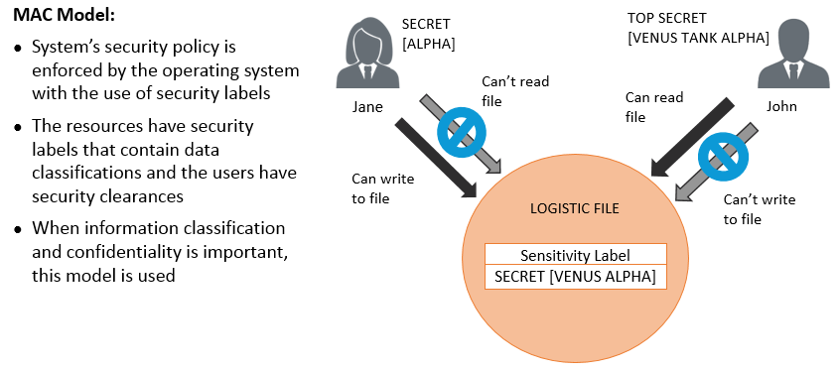
Access Control Models - MAC
Notes:
Section breaker slide with customer logo
Section heading – Arial Headings, 34, Bold
Sub head – Arial Headings, 18, normal
Used for a section heading. You may add a sub heading not exceeding one line also here
Section heading – Arial Headings, bold, 34 font size, should not exceed beyond 1 line
Sub Head – Arial Headings, normal, 18 font size, should not exceed beyond 1 line

Slide 33
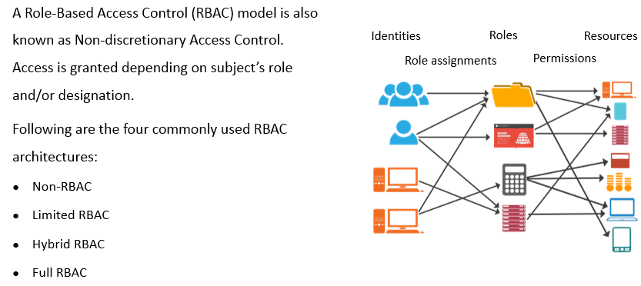
Access Control Models - RBAC
Notes:
Section breaker slide with customer logo
Section heading – Arial Headings, 34, Bold
Sub head – Arial Headings, 18, normal
Used for a section heading. You may add a sub heading not exceeding one line also here
Section heading – Arial Headings, bold, 34 font size, should not exceed beyond 1 line
Sub Head – Arial Headings, normal, 18 font size, should not exceed beyond 1 line

Slide 34
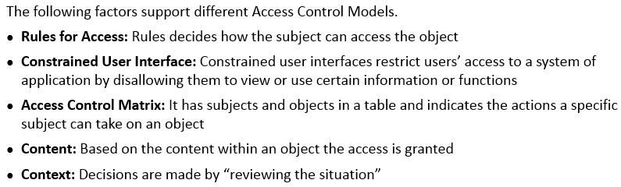
Access Control - Concepts
Notes:
Section breaker slide with customer logo
Section heading – Arial Headings, 34, Bold
Sub head – Arial Headings, 18, normal
Used for a section heading. You may add a sub heading not exceeding one line also here
Section heading – Arial Headings, bold, 34 font size, should not exceed beyond 1 line
Sub Head – Arial Headings, normal, 18 font size, should not exceed beyond 1 line

Slide 35
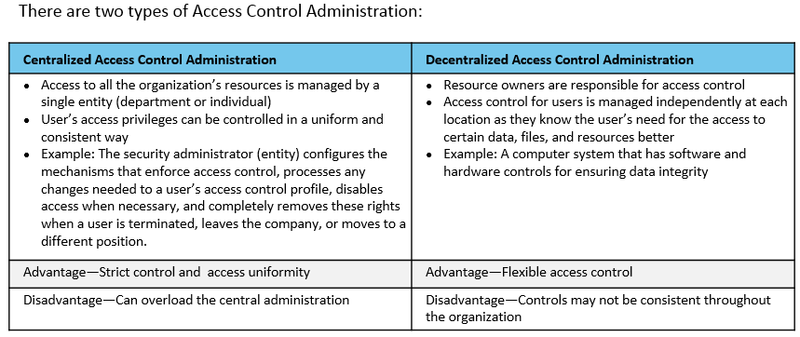
Access Control Administration - Types
Notes:
Section breaker slide with customer logo
Section heading – Arial Headings, 34, Bold
Sub head – Arial Headings, 18, normal
Used for a section heading. You may add a sub heading not exceeding one line also here
Section heading – Arial Headings, bold, 34 font size, should not exceed beyond 1 line
Sub Head – Arial Headings, normal, 18 font size, should not exceed beyond 1 line

Slide 36
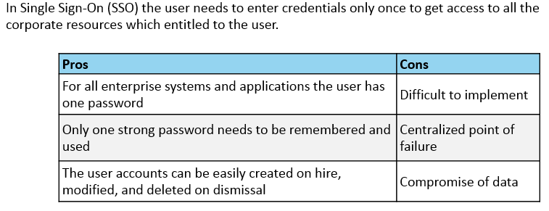
Single Sign On
Notes:
Section breaker slide with customer logo
Section heading – Arial Headings, 34, Bold
Sub head – Arial Headings, 18, normal
Used for a section heading. You may add a sub heading not exceeding one line also here
Section heading – Arial Headings, bold, 34 font size, should not exceed beyond 1 line
Sub Head – Arial Headings, normal, 18 font size, should not exceed beyond 1 line

Slide 37
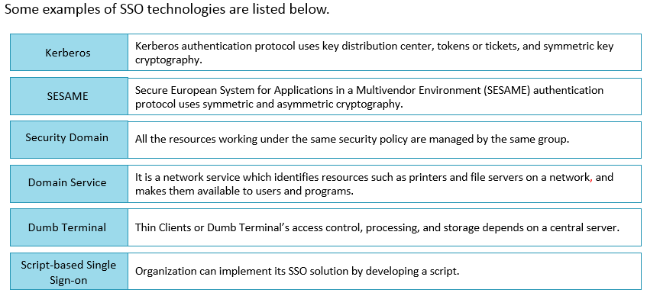
SSO Technologies
Notes:
Section breaker slide with customer logo
Section heading – Arial Headings, 34, Bold
Sub head – Arial Headings, 18, normal
Used for a section heading. You may add a sub heading not exceeding one line also here
Section heading – Arial Headings, bold, 34 font size, should not exceed beyond 1 line
Sub Head – Arial Headings, normal, 18 font size, should not exceed beyond 1 line

Slide 38
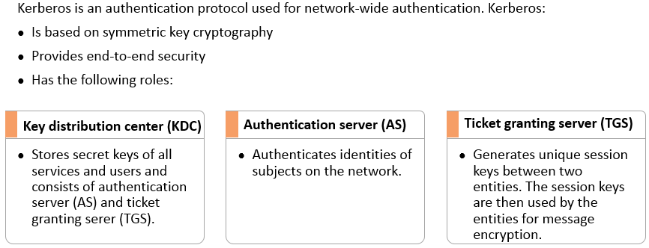
Kerberos
Notes:
Section breaker slide with customer logo
Section heading – Arial Headings, 34, Bold
Sub head – Arial Headings, 18, normal
Used for a section heading. You may add a sub heading not exceeding one line also here
Section heading – Arial Headings, bold, 34 font size, should not exceed beyond 1 line
Sub Head – Arial Headings, normal, 18 font size, should not exceed beyond 1 line

Slide 39
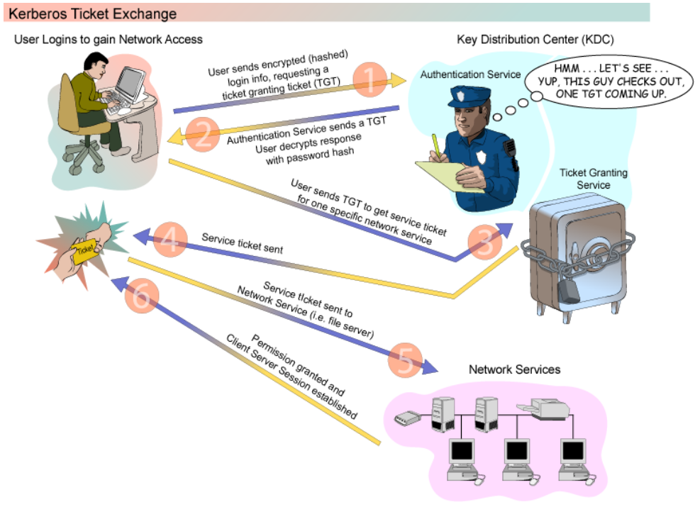

Slide 40

Kerberos - Problems
Notes:
Section breaker slide with customer logo
Section heading – Arial Headings, 34, Bold
Sub head – Arial Headings, 18, normal
Used for a section heading. You may add a sub heading not exceeding one line also here
Section heading – Arial Headings, bold, 34 font size, should not exceed beyond 1 line
Sub Head – Arial Headings, normal, 18 font size, should not exceed beyond 1 line

Slide 41
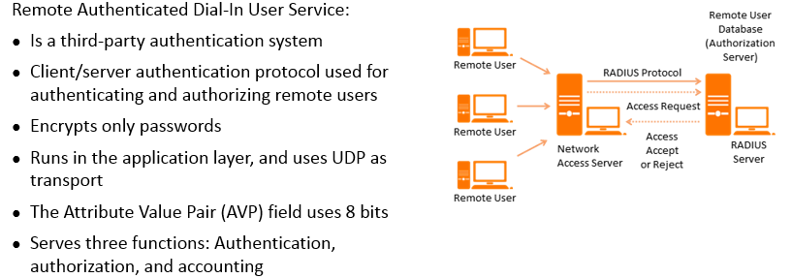
Remote Authentication Dial In User Service (RADIUS)
Notes:
Section breaker slide with customer logo
Section heading – Arial Headings, 34, Bold
Sub head – Arial Headings, 18, normal
Used for a section heading. You may add a sub heading not exceeding one line also here
Section heading – Arial Headings, bold, 34 font size, should not exceed beyond 1 line
Sub Head – Arial Headings, normal, 18 font size, should not exceed beyond 1 line

Slide 42
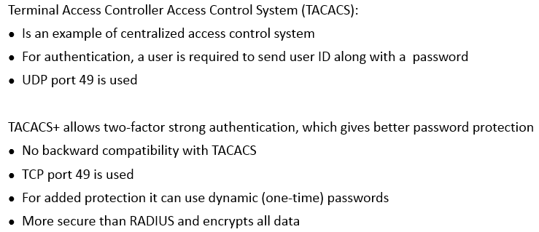
TACACS and TACACS+
Notes:
Section breaker slide with customer logo
Section heading – Arial Headings, 34, Bold
Sub head – Arial Headings, 18, normal
Used for a section heading. You may add a sub heading not exceeding one line also here
Section heading – Arial Headings, bold, 34 font size, should not exceed beyond 1 line
Sub Head – Arial Headings, normal, 18 font size, should not exceed beyond 1 line

Slide 43
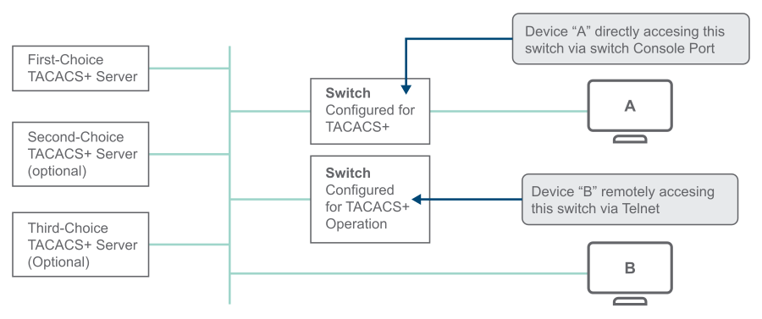
Notes:
The switch queries the first-choice TACACS+ server for authentication of the request.If the switch does not receive a response from the first-choice TACACS+ server, it attempts to query a secondary server, second-choice and third-choice. If the switch does not receive a response from any TACACS+ server, then it uses its own local user name/password pairs to authenticate the logon request, see Local authentication process.
If a TACACS+ server recognizes the switch, it forwards a user name prompt to the requesting terminal via the switch.
When the requesting terminal responds to the prompt with a user name, the switch forwards it to the TACACS+ server.
After the server receives the user name input, the requesting terminal receives a password prompt from the server via the switch.
When the requesting terminal responds to the prompt with a password, the switch forwards it to the TACACS+ server and one of the following actions occurs:
If the user name/password pair received from the requesting terminal matches a user name/password pair previously stored in the server, the server passes access permission through the switch to the terminal.
If the user name/password pair entered at the requesting terminal does not match a user name/password pair previously stored in the server, access is denied. In this case, the terminal is again prompted to enter a user name and repeat steps 2 through 4 In the default configuration, the switch allows up to three attempts to authenticate a login session. If the requesting terminal exhausts the attempt limit without a successful TACACS+ authentication, the login session is terminated and the operator at the requesting terminal must initiate a new session before trying again.

Slide 44
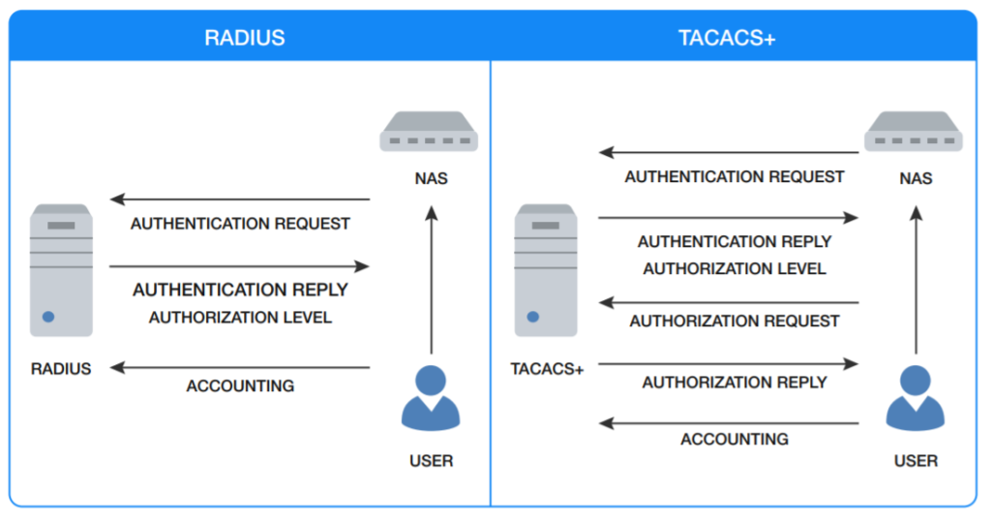

Slide 45
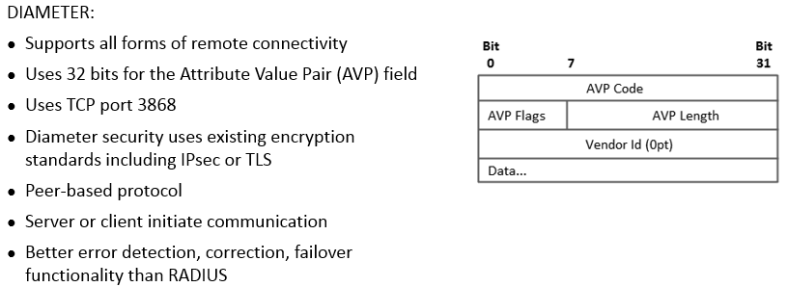
DIAMETER
Notes:
Section breaker slide with customer logo
Section heading – Arial Headings, 34, Bold
Sub head – Arial Headings, 18, normal
Used for a section heading. You may add a sub heading not exceeding one line also here
Section heading – Arial Headings, bold, 34 font size, should not exceed beyond 1 line
Sub Head – Arial Headings, normal, 18 font size, should not exceed beyond 1 line

Slide 46
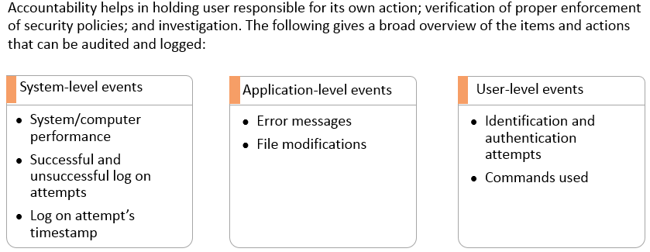
Accountability
Notes:
Section breaker slide with customer logo
Section heading – Arial Headings, 34, Bold
Sub head – Arial Headings, 18, normal
Used for a section heading. You may add a sub heading not exceeding one line also here
Section heading – Arial Headings, bold, 34 font size, should not exceed beyond 1 line
Sub Head – Arial Headings, normal, 18 font size, should not exceed beyond 1 line

Slide 47
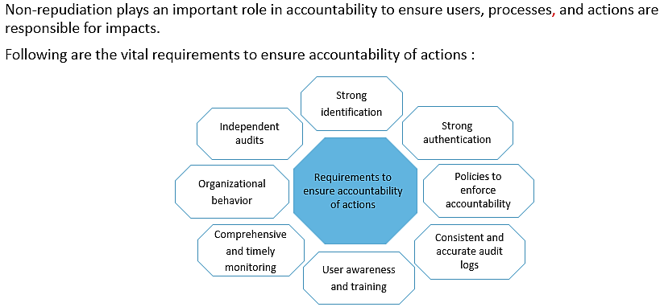
Accountability
Notes:
Section breaker slide with customer logo
Section heading – Arial Headings, 34, Bold
Sub head – Arial Headings, 18, normal
Used for a section heading. You may add a sub heading not exceeding one line also here
Section heading – Arial Headings, bold, 34 font size, should not exceed beyond 1 line
Sub Head – Arial Headings, normal, 18 font size, should not exceed beyond 1 line

Slide 48
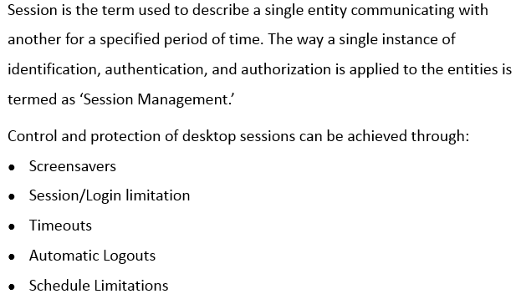
Session Management
Notes:
Section breaker slide with customer logo
Section heading – Arial Headings, 34, Bold
Sub head – Arial Headings, 18, normal
Used for a section heading. You may add a sub heading not exceeding one line also here
Section heading – Arial Headings, bold, 34 font size, should not exceed beyond 1 line
Sub Head – Arial Headings, normal, 18 font size, should not exceed beyond 1 line

Slide 49
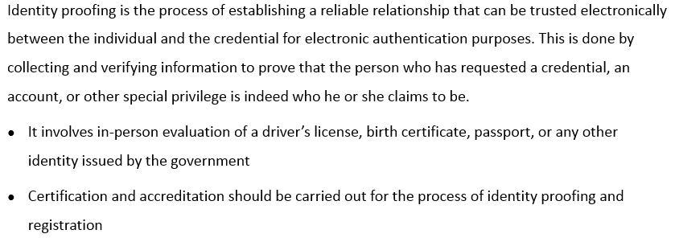
Registration and Proof of Identity
Notes:
Section breaker slide with customer logo
Section heading – Arial Headings, 34, Bold
Sub head – Arial Headings, 18, normal
Used for a section heading. You may add a sub heading not exceeding one line also here
Section heading – Arial Headings, bold, 34 font size, should not exceed beyond 1 line
Sub Head – Arial Headings, normal, 18 font size, should not exceed beyond 1 line

Slide 50
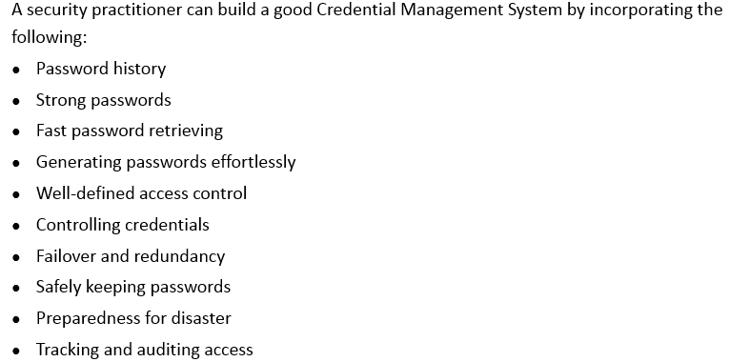
Credential Management Systems (CMS)
Notes:
Section breaker slide with customer logo
Section heading – Arial Headings, 34, Bold
Sub head – Arial Headings, 18, normal
Used for a section heading. You may add a sub heading not exceeding one line also here
Section heading – Arial Headings, bold, 34 font size, should not exceed beyond 1 line
Sub Head – Arial Headings, normal, 18 font size, should not exceed beyond 1 line

Slide 51
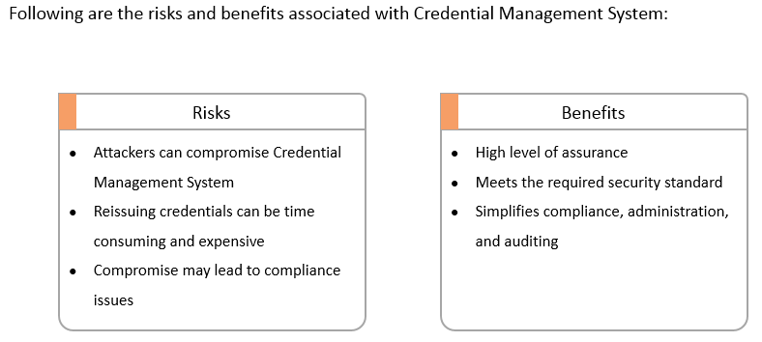
Credential Management Systems (CMS) – Risks vs Benefits
Notes:
Section breaker slide with customer logo
Section heading – Arial Headings, 34, Bold
Sub head – Arial Headings, 18, normal
Used for a section heading. You may add a sub heading not exceeding one line also here
Section heading – Arial Headings, bold, 34 font size, should not exceed beyond 1 line
Sub Head – Arial Headings, normal, 18 font size, should not exceed beyond 1 line

Slide 52
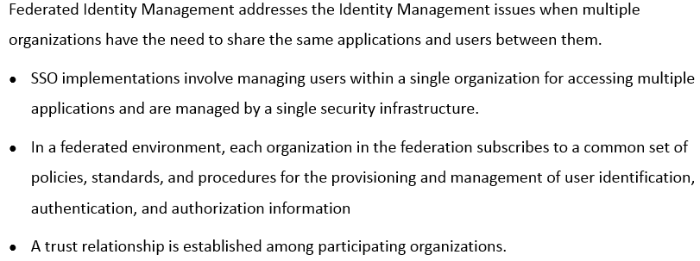
Federated Identity Management
Notes:
Section breaker slide with customer logo
Section heading – Arial Headings, 34, Bold
Sub head – Arial Headings, 18, normal
Used for a section heading. You may add a sub heading not exceeding one line also here
Section heading – Arial Headings, bold, 34 font size, should not exceed beyond 1 line
Sub Head – Arial Headings, normal, 18 font size, should not exceed beyond 1 line

Slide 53

Federated Identity Management - Models
Notes:
Section breaker slide with customer logo
Section heading – Arial Headings, 34, Bold
Sub head – Arial Headings, 18, normal
Used for a section heading. You may add a sub heading not exceeding one line also here
Section heading – Arial Headings, bold, 34 font size, should not exceed beyond 1 line
Sub Head – Arial Headings, normal, 18 font size, should not exceed beyond 1 line

Slide 54

Federated Identity Management – Models (contd)
Notes:
Section breaker slide with customer logo
Section heading – Arial Headings, 34, Bold
Sub head – Arial Headings, 18, normal
Used for a section heading. You may add a sub heading not exceeding one line also here
Section heading – Arial Headings, bold, 34 font size, should not exceed beyond 1 line
Sub Head – Arial Headings, normal, 18 font size, should not exceed beyond 1 line

Slide 55

Federated Identity Management – Models (contd)
Notes:
Section breaker slide with customer logo
Section heading – Arial Headings, 34, Bold
Sub head – Arial Headings, 18, normal
Used for a section heading. You may add a sub heading not exceeding one line also here
Section heading – Arial Headings, bold, 34 font size, should not exceed beyond 1 line
Sub Head – Arial Headings, normal, 18 font size, should not exceed beyond 1 line

Slide 56
Local Identities
Single Domain
Federated Identity
SSO
Weak Passwords, Password Reuse
Compromise Scope,
Cred Theft Attacks,
Mass Compromise

Slide 57

Identity As A Service
Notes:
Section breaker slide with customer logo
Section heading – Arial Headings, 34, Bold
Sub head – Arial Headings, 18, normal
Used for a section heading. You may add a sub heading not exceeding one line also here
Section heading – Arial Headings, bold, 34 font size, should not exceed beyond 1 line
Sub Head – Arial Headings, normal, 18 font size, should not exceed beyond 1 line

Slide 58

Identity As A Service - Functionality
Notes:
Section breaker slide with customer logo
Section heading – Arial Headings, 34, Bold
Sub head – Arial Headings, 18, normal
Used for a section heading. You may add a sub heading not exceeding one line also here
Section heading – Arial Headings, bold, 34 font size, should not exceed beyond 1 line
Sub Head – Arial Headings, normal, 18 font size, should not exceed beyond 1 line

Slide 59

Identity As A Service – Possible Issues
Notes:
Section breaker slide with customer logo
Section heading – Arial Headings, 34, Bold
Sub head – Arial Headings, 18, normal
Used for a section heading. You may add a sub heading not exceeding one line also here
Section heading – Arial Headings, bold, 34 font size, should not exceed beyond 1 line
Sub Head – Arial Headings, normal, 18 font size, should not exceed beyond 1 line

Slide 60

Integrate Third Party Identity Services
Notes:
Section breaker slide with customer logo
Section heading – Arial Headings, 34, Bold
Sub head – Arial Headings, 18, normal
Used for a section heading. You may add a sub heading not exceeding one line also here
Section heading – Arial Headings, bold, 34 font size, should not exceed beyond 1 line
Sub Head – Arial Headings, normal, 18 font size, should not exceed beyond 1 line

Slide 61

Unauthorized Disclosure of Information
Notes:
Section breaker slide with customer logo
Section heading – Arial Headings, 34, Bold
Sub head – Arial Headings, 18, normal
Used for a section heading. You may add a sub heading not exceeding one line also here
Section heading – Arial Headings, bold, 34 font size, should not exceed beyond 1 line
Sub Head – Arial Headings, normal, 18 font size, should not exceed beyond 1 line

Slide 62

Access Control - Threats
Notes:
Section breaker slide with customer logo
Section heading – Arial Headings, 34, Bold
Sub head – Arial Headings, 18, normal
Used for a section heading. You may add a sub heading not exceeding one line also here
Section heading – Arial Headings, bold, 34 font size, should not exceed beyond 1 line
Sub Head – Arial Headings, normal, 18 font size, should not exceed beyond 1 line

Slide 63

Protection Against Access Control Attacks
Notes:
Section breaker slide with customer logo
Section heading – Arial Headings, 34, Bold
Sub head – Arial Headings, 18, normal
Used for a section heading. You may add a sub heading not exceeding one line also here
Section heading – Arial Headings, bold, 34 font size, should not exceed beyond 1 line
Sub Head – Arial Headings, normal, 18 font size, should not exceed beyond 1 line

Slide 64


Access Control – Best Practices
Notes:
Section breaker slide with customer logo
Section heading – Arial Headings, 34, Bold
Sub head – Arial Headings, 18, normal
Used for a section heading. You may add a sub heading not exceeding one line also here
Section heading – Arial Headings, bold, 34 font size, should not exceed beyond 1 line
Sub Head – Arial Headings, normal, 18 font size, should not exceed beyond 1 line

